Slide 1
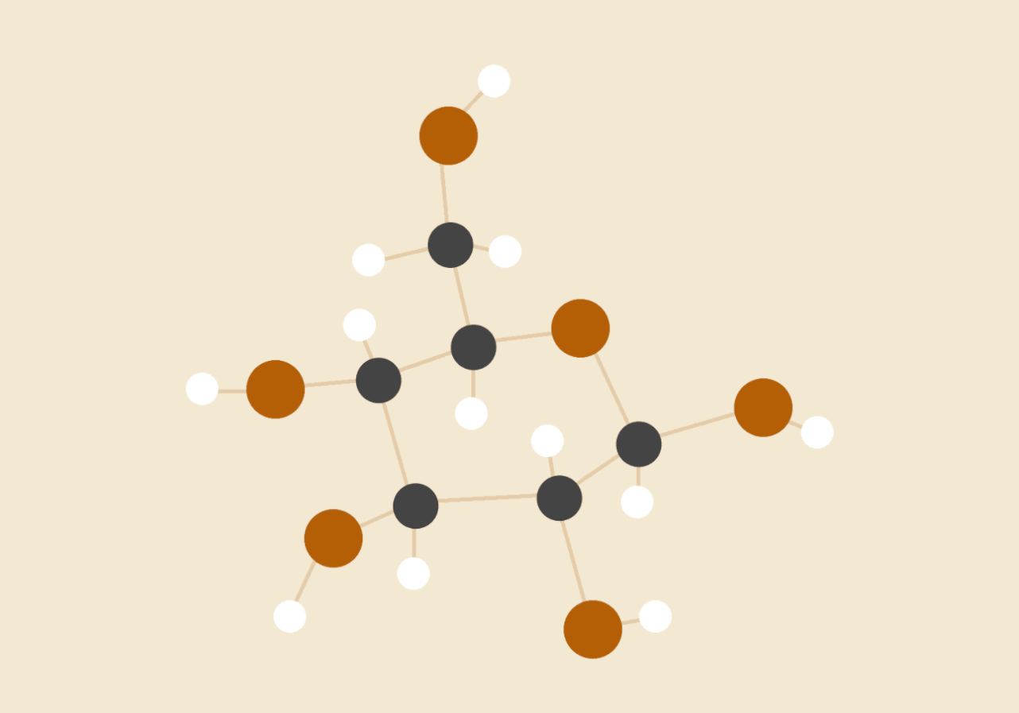
Consensus Propagation
Paper referred : Moallemi, C. C., & Roy, B. V. (2006, Mar 19). Consensus Propagation. IEEE Transactions on Information Theory, 2006,, VOL. 52(NO. 11), 19.

Slide 2
Contents
Problem statement
Solution proposed
Relevance of the problem
Algorithms and formulas
Auxiliary work
Observations

Slide 3
Problem Statement
Consider a network of n nodes in which the i_{th} node observes a real number y_{i} ∈ R and aims to compute the average of all y_{i}’s.
The purpose is to reach the best possible estimate for all nodes, through local processing and information exchange over the network.
This is a type of consensus estimation problem.

Slide 4
Solution Proposed
(Moallemi & Roy, 2006) proposes an asynchronous protocol, consensus propagation as a solution to the problem.
It is a distributed protocol, each node only requires locally available information.
No central entity, able to contact all nodes, is present.
It is an Asynchronous protocol, i.e., only a subset of messages transmitted at each time.
The algorithm converges for all graphs.
But, the convergence time is known to be bounded only for regular graphs and trees.

Slide 5
Relevance of the problem
Demand of distributed processing and pervasive computing and communications is increasing.
Protocol for calculating mean is necessary to compute other more complex things (examples below).
Eg. Distributed optimization methods, load balancing and clock synchronization are a few to name.

Slide 6
Algorithms and
Formulas
Trees and general graphs

Slide 7
Message Propagation
For every iteration of the algorithm two functions fires in each node -
Send message - Every node construct a specific message for each of its neighbour and send that message to each of them respectively.
Calculate - Each node will use the message it got from its neighbour and tries to calculate the new mean estimate from that information.

Slide 8
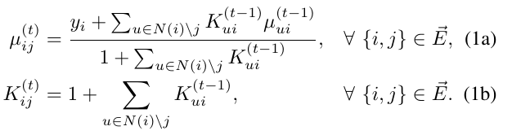
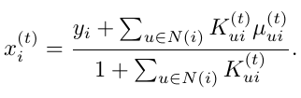

Trees
Calculation of parameters μ_{ij}(t) and K_{ij}(t) from the messages received at (t-1)^{th} iteration.
The global average x(i) is calculated at each node, at time t.
Thus, for any i ∈ V , and t sufficiently large, above equivalence holds.

Slide 9
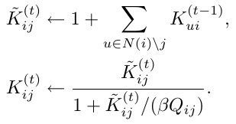
General graph
If we use the same algo as previously mentioned, then for cyclic graphs, K_{ij}(t) -> ∞.
(Moallemi & Roy, 2006) provides this recipe for updating the cardinality K_{ij} (t).
Factors ꞵ>0 and Q_{ij} are positive constants.
This is done to attenuate the value of cardinality in cases of cyclic graphs.

Slide 10
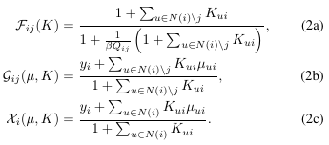
General graph contd.
These are formulas for cardinality, message to be sent and newly calculated mean to be stored in the node respectively.

Slide 11
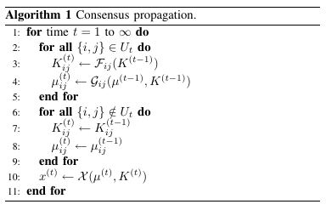
Final algorithm for general graph
Pseudo code from lines 6 to 9 are basically asynchronous implementations of the algorithm.

Slide 12
Auxiliary Work Done
Implemented our own parser for the gml files.
Implemented our own interval graph generator.
Functions to connect unconnected graph and get spanning tree out of it.
Used Kruskal's algorithm to get the spanning tree.
We implemented the disjoint set data structure used in Kruskal’s algorithm, from scratch.

Slide 13
Observations
The number of iterations taken by tree-algorithm is equal to the diameter in the case of tree graphs.
The proposed graph-algorithm also converges but the iterations taken to converge can’t be determined for every graph.(can only be upper bounded for d-regular graphs)
Std. deviation for the predicted mean increases as the connectivity in the cycle increases.(i.e. Clique no. of graph increases.)

Slide 14
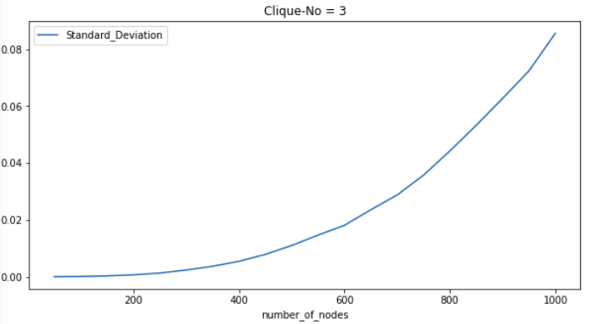
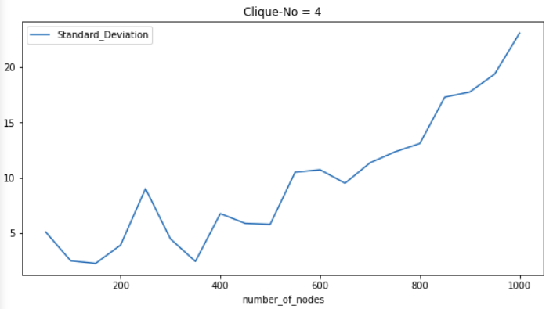
Observations
Below are some experimental results observed in case of interval graphs, when we increase clique-no from three to four.
NOTE : For simplification purposes, if total no. of nodes = k, then values in the nodes vary from 1 to k, therefore the actual mean is ------(k)*(k+1)/2.

Slide 15
Observations
As is clearly visible by the above graphs ------
When clique-no=3 , standard deviation increases very little(0 to 0.08) on increasing the total number of nodes from 50 to 1000.
While when clique-no = 4, even at a graph consisting of 50 nodes std.Deviation has a much larger magnitude (5 units) .
Magnitude of std.Deviation varies from 5 to 20 units for when the number of nodes varies from 50 to 1000.(for clique-no = 4)
Therefore, deviation depends less on the number of nodes and more on the dense cyclic connectivity of the graph.( when clique-no increases from 3 to 4, the connectivity also becomes dense)

Slide 16
THANKS!
Group members -
Mukesh Singh 2018UCS0062
Navdeep Singh 2018UCS0080
Vineet Bakshi 2018UCS0066

